Slide 1
GSFC Mobile Lidar Station Report
T. McGee, J. Sullivan

Slide 2
Current Status
Tropospheric Ozone Lidar
  Status report given by John Sullivan on Monday
Aerosol and Temperature Lidar
  New radar system has been built and is currently being installed
  Increased range – no observer required (hopefully)
  Identical to previously tested radar system with FAA approval to operate with out an outside observer
  When complete will travel to Table Mountain for water vapor and rotational Raman temperature comparisons
Stratospheric Ozone Lidar
  Currently at OHP prior to shipment to Hohenpeissenberg, Germany
  Followed by Reunion and Lauder, NZ (Agreements in process at NASA)

Slide 3
Status Report (cont)
Additional International Agreements now winding through the NASA HQ approval maze
  La Reunion – this is an extension to a recently expired agreement to allow for completion of the MORGANE Campaign (2015). This campaign resulted in a total, fatal excimer failure in the STROZ lidar.
    Laser was replaced in 2017 with a new Light Machinery XeCl laser
  New Zealand – The stratospheric ozone lidar at the NIWA site in Lauder (45 S) is undergoing major modifications to the detector system and so is in line for another validation campaign.
  Argentina – a validation campaign at Rio Gallegos has been discussed for some time. This is awaiting some responses from Argentina related to the responsibilities for each of the parties

Slide 4
GSFC STROZ Lidar at OHP
T. McGee, J Sullivan, G. Sumnicht, L. Twigg, S. Godin-Beekmann, R. Wing, A. Hauchecorne

Slide 5
NDACC Validation Campaigns
NDACC Validation Protocols call for “periodic” independent, blind comparisons to establish data credibility
GSFC Developed a mobile stratospheric ozone lidar to be used as a transfer standard for similar instruments around the world
For each such campaign, a well respected scientist was selected to serve as an independent referee to collect the data and ensure the blind nature of the comparisons
Over the years the GSFC STROZ Lidar has been deployed from 79.5° N to 45° S
Campaigns began with a major effort at Table Mountain in 1989, before NDSC was even chartered (1991)

Slide 6
Lavande 2017-2018
Campaign name symbolic of the lavender field prevalent in Provence during June and July
Wolfgang Steinbrecht was selected to be the referee
Campaign took place over two time periods – July, 2017, and March, 2018
July measurements were truncated by a capacitor failure in the GSFC excimer laser (July 17, 2017).
Temperature measurements continued after the excimer failure
Excimer was repaired and measurements resumed in March of 2018
Six coincident ozone and temperature measurements were obtained before excimer failure in July – Additional five temperature measurements after laser failure
Five coincident ozone and temperature measurements in March, 2018
Some difficulty with loss of sync between laser systems. Data filtered.

Slide 7
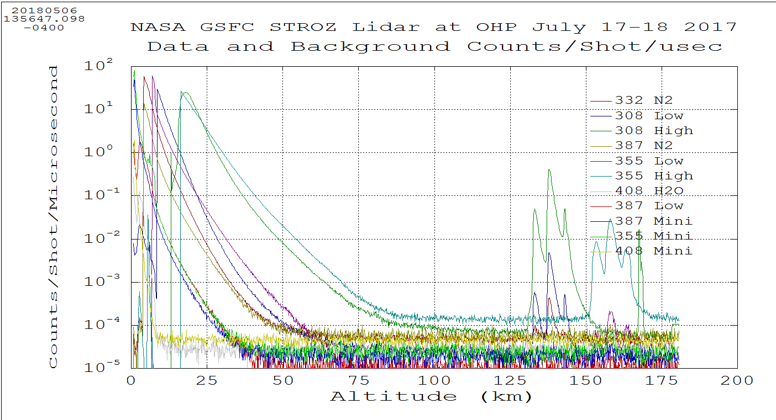
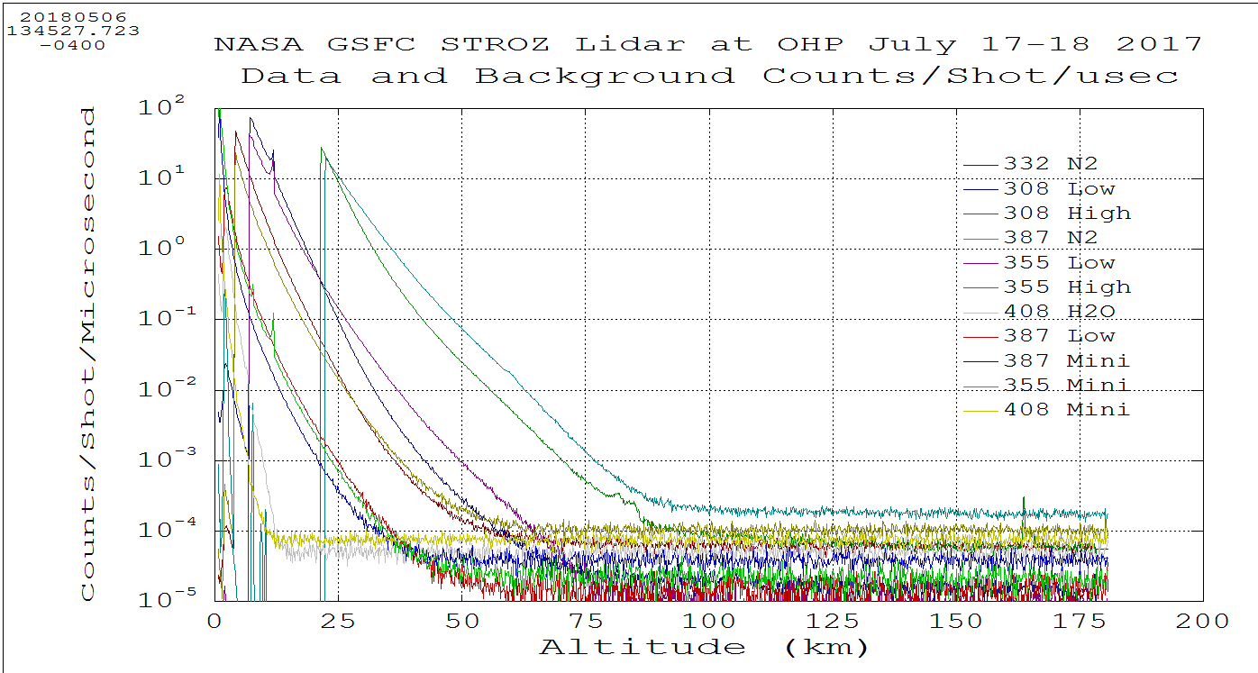
Example of Laser Interference

Slide 8
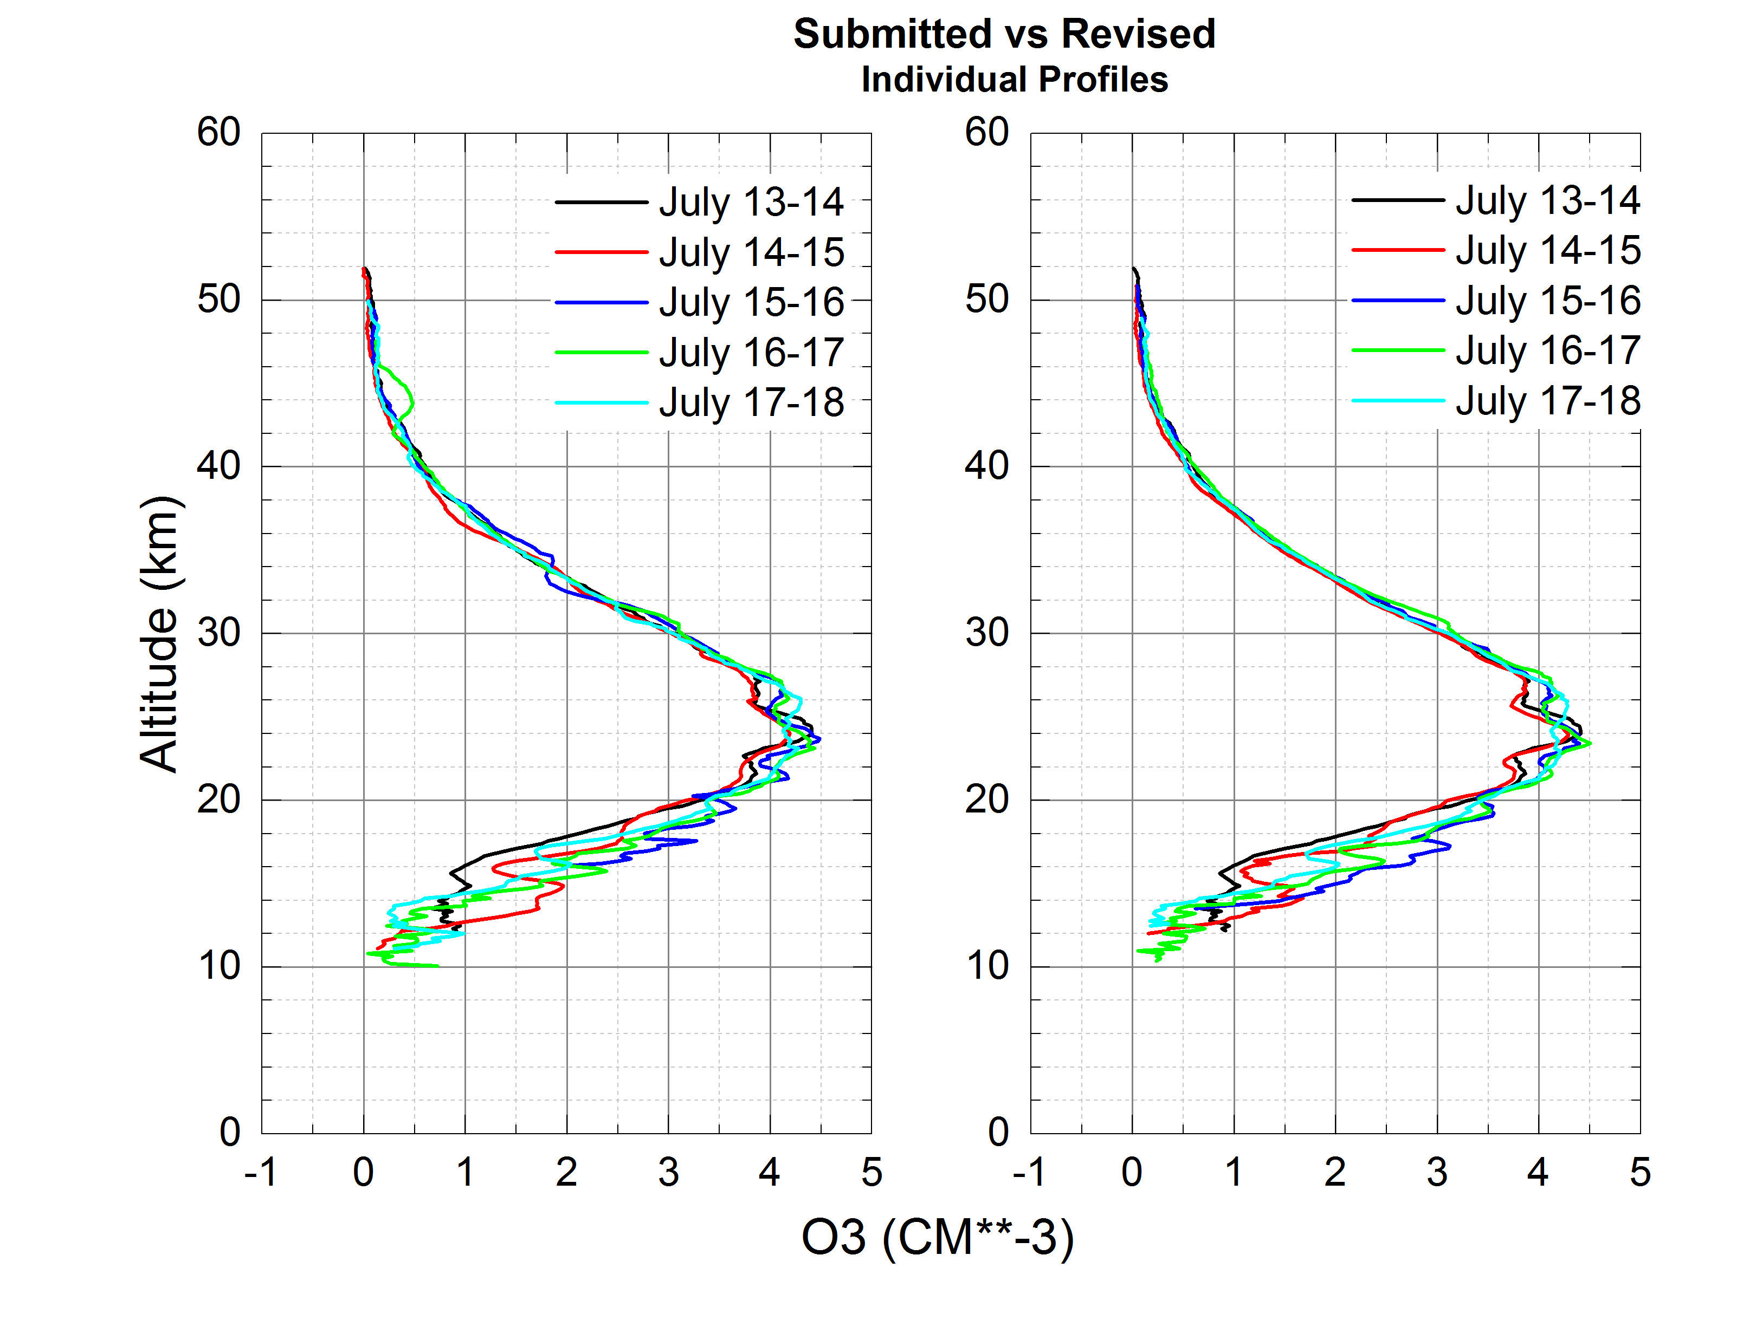
GSFC Data Revised vs Submitted
Three curious features
~750 20 sec data files
Concern for laser interference in return signals
Additional filtering of datasets led to elimination of about a dozen files
Much better agreement in plots after removal of datasets

Slide 9
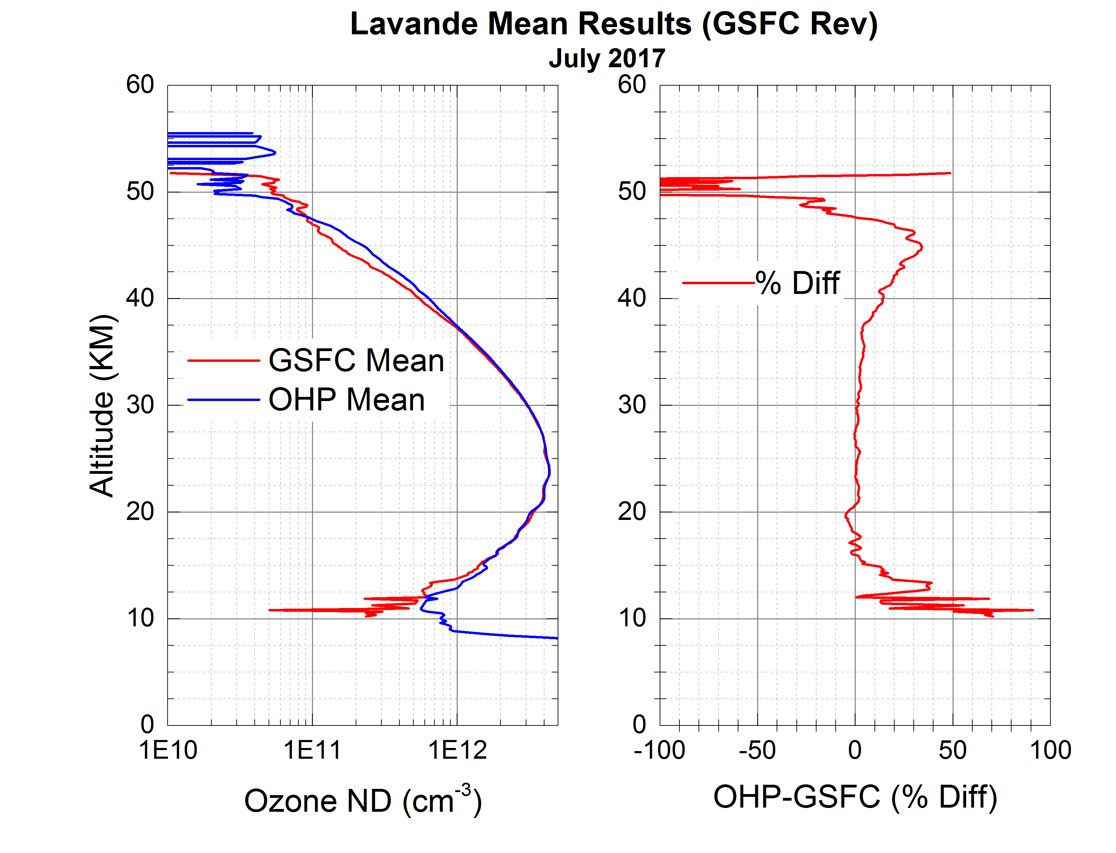
Preliminary Result – July 2017
Additional Filtering has helped the overall agreement between OHP and GSFC results
Between 15-38 km the differences are less than 5% between the two groups
But the difference is about 30% at 45 km which is not usually the case.
Differences in Vertical resolution may explain some but not all f this difference. Possibly some laser interference still remains in either or both groups data
Temperature retrievals are also being looked at.
Referee will complete official analysis

Slide 10
GSFC at Lavande, July ‘17/March ‘18
STROZ Column vs OMI
Lidar column is calculated from measurements
Column above and below lidar data is calculated from the US Standard Atmosphere
GSFC computed column is plotted in the red dots
Serves as a “reasonableness” check
LAVANDE NDACC Campaign

Slide 11
Where do we go from here?

Slide 12
Where do we go from here?
Check altitude registration – both wavelengths
  Thin cirrus provides a good reference

Slide 13
Where do we go from here?
Check altitude registration – both wavelengths.
  Thin cirrus provides a good reference
Is all cross-interference removed? Particularly above 40 km.

Slide 14
Where do we go from here?
Check altitude registration – both wavelengths.
  Thin cirrus provides a good reference
Is all cross-interference removed? Particularly above 40 km.
Retrieve profiles using a common vertical resolution

Slide 15
Where do we go from here?
Check altitude registration – both wavelengths.
  Thin cirrus provides a good reference
Is all cross-interference removed? Particularly above 40 km.
Retrieve profiles using a common vertical resolution
Retrieve with a common algorithm (Any volunteers, Thierry???)

Slide 16
Where do we go from here?
Check altitude registration – both wavelengths.
  Thin cirrus provides a good reference
Is all cross-interference removed? Particularly above 40 km.
Retrieve profiles using a common vertical resolution
Retrieve with a common algorithm (Any volunteers, Thierry???)
Temperature comparisons with OHP ozone lidar retrieval and the OHP Temperature Lidar

Slide 17
Where do we go from here?
Check altitude registration – both wavelengths.
  Thin cirrus provides a good reference
Is all cross-interference removed? Particularly above 40 km.
Retrieve profiles using a common vertical resolution
Retrieve with a common algorithm (Any volunteers, Thierry???)
Temperature comparisons with OHP ozone lidar retrieval and the OHP Temperature Lidar
Water Vapor Comparisons? GSFC reliable to ~ 7 km (Longer term goal)

Slide 18
Where do we go from here?
Check altitude registration – both wavelengths.
  Thin cirrus provides a good reference
Is all cross-interference removed? Particularly above 40 km.
Retrieve profiles using a common vertical resolution
Retrieve with a common algorithm (Any volunteers, Thierry???)
Temperature comparisons with OHP ozone lidar retrieval and the OHP Temperature Lidar
Water Vapor Comparisons? GSFC reliable to ~ 7 km (Longer term goal)
Incorporate March lidar data, sonde data, any other available profile data

